Slide 1
Week 6 Update
19 February 2021
sr

Slide 2
Problem Definition
sr
Notes:
1.5’ - DG

Slide 3
Problem Definition
There does not exist a ready-to-use computational model capable of measuring total lower body muscle activation energy expenditure for a cycling simulation.
Overarching Goal
Using OpenSim software, we will develop a usable model which takes in saddle position as the primary input and reports muscle-based metabolic energy expenditure as the primary output.
Progressive Goals
Evaluate metabolic energy expenditure data in OpenSim for a simplified cycling model.
Develop an increasingly realistic and parameterizable model to generate the relationship between saddle position and metabolic energy expenditure data.
sr
Notes:
“So what does that mean?”
There isn’t a software tool that Specialized can input a rider’s dimensions, cadence, and power stroke and immediately measure or predict what that rider’s energy expenditure would be like. Such a tool would be beneficial in the way of using metabolic energy consumption as a benchmark for whether or not a bike is a good fit for a cyclist. Which takes us to our overarching goal…
-> Overarching Goal…
And as stepping stones to that goal...

Slide 4
Problem Context
sr
Notes:
1.5-2’ CEC

Slide 5
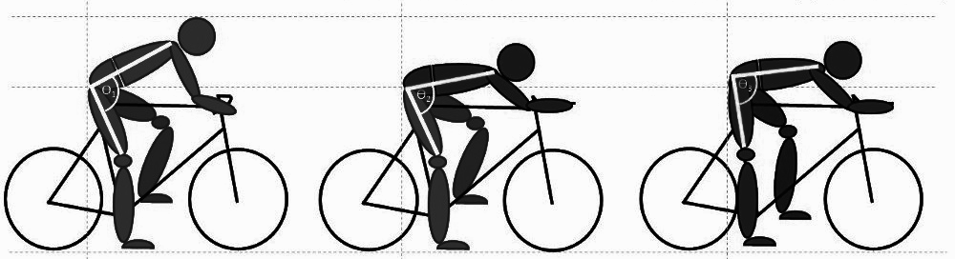
Problem Context
To our knowledge, there is no established workflow incorporating purely computational tools for quantifying the change in cycling muscle-based metabolic energy expenditure based on changes in seat positions
[16]
Changing the hip angle affects metabolic energy, power, muscle activation, body kinematics, and aerodynamic drag [2]
sr
Notes:
As seen in the image, changing the hip angle affects metabolic energy, power, muscle activation, body kinematics, and aerodynamic drag [2]
Aerodynamic drag has proven to be a significant player in affecting overall cyclist efficiency [2]
not being considered in the scope of this project but may be added later by Specialized
It is very important to note that data has suggested that “reducing hip angle is outweighed by the aerodynamic benefit and that riders should favor aerodynamic optimization for shorter [cycling events]” [2] and this is a possible area for additional future investigation.

Slide 6
Background
cc
Notes:
3-4- SR
Prior studies in human biomechanics of cycling have shown that power can be measured through different methods [2], [9], [10], or calculated through analytical solutions [8], [11], [12]. Metabolic cost of human movement is most often measured via indirect calorimetry through a metric of oxygen uptake (V̇O₂) [4], [5], [6], [7]. Running performance has been shown to be positively correlated to oxygen expenditure [1], and thus metabolic consumption, and this methodology may be applied to other movement, such as cycling performance.

Slide 7
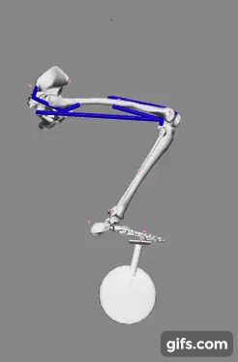
Past Stanford Project Cycling Model
Acquired one-legged OpenSim cycling model from ME485: Modeling/Simulation of Human Movement
Limited complexity with only 4 muscles, pelvis location pinned, and foot location constrained
Building upon their successful forward dynamics simulations
Two-muscle actuation showcasing simplified cycling kinematics [5]
cc
Notes:
Title of course
Fix animation

Slide 8
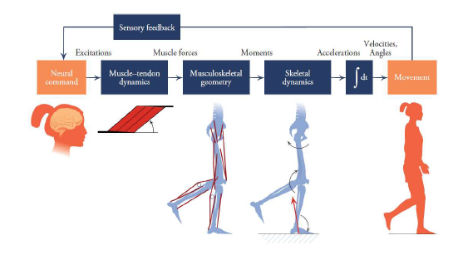
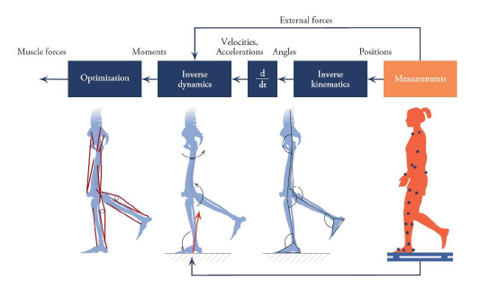
Forward Dynamics (L) vs. Inverse Dynamics (R)
Source: Figure 1.12 and Figure 1.13 Biomechanics of Movement: The Science of Sports, Robotics, and Rehabilitation by Thomas K. Uchida and Scott L. Delp (2020)
cc

Slide 9
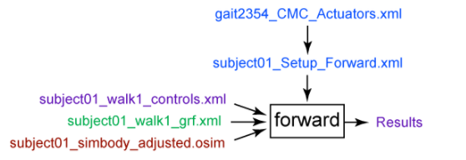
OpenSim Crash Course
Forward Dynamics
The Forward Dynamics Tool is used to calculate joint kinematics based on assumed muscle activations.
Simplest tool
Downside: Muscle activations assumed.
https://simtk-confluence.stanford.edu/display/OpenSim/Getting+Started+with+Forward+Dynamics
Inputs: Muscle excitation w.r.t. time, constraints on bodies’ coordinates (e.g. pelvis xyz-position, foot-on-pedal)
Outputs: Can obtain a wide array of outputs while muscle activation drives the simulation. Most useful will typically be joint angles, muscle-fiber lengths, and other body kinematics.
cc
Notes:
The purpose of inverse kinematics (IK) is to estimate joint angles from experimental data. The purpose of inverse dynamics (ID) is to estimate forces & moments.
CMC is likely our primary tool for obtaining the relevant muscle forces with a well defined trajectory (joint angles) and external loads (pedal reaction forces)

Slide 10
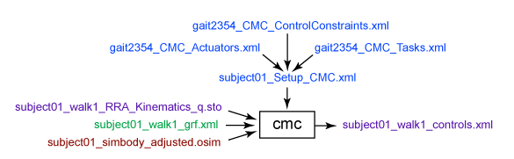
OpenSim Crash Course
CMC Tool (Computed Muscle Control)
The CMC tool is used to calculate muscle excitations based on desired kinematic inputs under various constraints/ boundary conditions.
Difficult to obtain convergence/ optimization
https://simtk-confluence.stanford.edu/display/OpenSim/Getting+Started+with+CMC
Inputs: Kinematics (joint angles, translations), coordinate tracking requests, constraints, actuation, GRFs
Outputs: Muscle activation forces, muscle activations/controls, muscle states of motion (joint angles & velocities; muscle fiber lengths & activations)
Ability to request Metabolic Probes
CMC Tool incorporate principles from Inverse Kinematics (IK) & Inverse Dynamics (ID) workflows
cc
Notes:
The purpose of inverse kinematics (IK) is to estimate joint angles from experimental data. The purpose of inverse dynamics (ID) is to estimate forces & moments.
CMC is likely our primary tool for obtaining the relevant muscle forces with a well defined trajectory (joint angles) and external loads (pedal reaction forces)

Slide 11
Workflow, Model, Testing & Early Results
dg
Notes:
5-8 - all

Slide 12
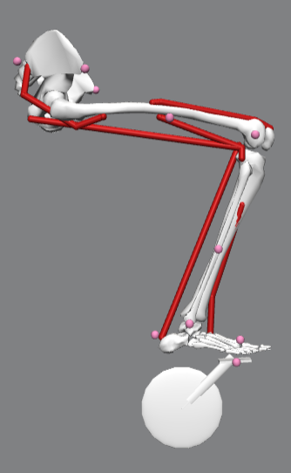
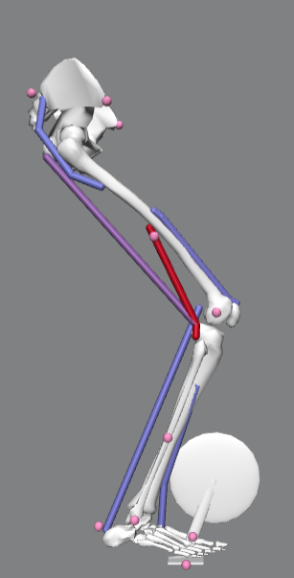
Workflow
Computed Muscle Control (CMC)
Parameterized input: Saddle Position
Forward Kinematics
Muscles Activation: [A₁]
Muscles Forces: [M₁]
Metabolic Energy Expenditure:
E₁
Trial 1 (x₁ , y₁)
Joint Angles: [Q₁]
Muscles Lengths: [L₁]
Muscles Velocities: [V₁]
External forces: [F₁]
dg
Notes:
Parameters: GRFs, saddle height/position, kinematics, cadence,
The first step will always be making any necessary adjustments we need to make to the OpenSim model for the next iteration. It’s at this point where we choose a new saddle position for a example.
Then we generate a new set of joint angle trajectories and external force profiles using the adjusted model for our CMC Tool.
We then need to tailor the OpenSim specific files and scripts that the CMC Tool requires. The content of these files are directly influenced by every aspect of the OpenSim model, and so they must be updated for every physical change made to the model.
With all of the files needed for the CMC Tool organized, we can finally simulate a pedaling motion for the model and extract outputs of interest such as muscle excitation profiles and metabolic energy consumption probes.
Lastly, before beginning a new iteration cycle, it is important to compare the simulation outputs to our previous iterations to judge what qualitative improvements are being made.

Slide 13
Workflow
Computed Muscle Control (CMC)
Parameterized input: Saddle Position
Forward Kinematics
Muscles Activation: [A₁ , A₂]
Muscles Forces: [M₁ , M₂]
Metabolic Energy Expenditure:
[E₁ , E₂]
Trial 1 (x₁ , y₁)
Joint Angles: [Q₁ , Q₂]
Muscles Lengths: [L₁ , L₂]
Muscles Velocities: [V₁ , V₂]
External forces: [F₁ , F₂]
Trial 2 (x₂ , y₂)
dg
Notes:
Parameters: GRFs, saddle height/position, kinematics, cadence,
The first step will always be making any necessary adjustments we need to make to the OpenSim model for the next iteration. It’s at this point where we choose a new saddle position for a example.
Then we generate a new set of joint angle trajectories and external force profiles using the adjusted model for our CMC Tool.
We then need to tailor the OpenSim specific files and scripts that the CMC Tool requires. The content of these files are directly influenced by every aspect of the OpenSim model, and so they must be updated for every physical change made to the model.
With all of the files needed for the CMC Tool organized, we can finally simulate a pedaling motion for the model and extract outputs of interest such as muscle excitation profiles and metabolic energy consumption probes.
Lastly, before beginning a new iteration cycle, it is important to compare the simulation outputs to our previous iterations to judge what qualitative improvements are being made.

Slide 14
Workflow
Computed Muscle Control (CMC)
Parameterized input: Saddle Position
Forward Kinematics
Muscle Activation: [A₁ , A₂ , … A_{n}]
Muscle Forces: [M₁ , M₂ , … M_{n}]
Metabolic Energy Expenditure:
[E₁ , E₂ , … E_{n}]
Trial 1 (x₁ , y₁)
Joint Angles: [Q₁ , Q₂ , … Q_{n}]
Muscle Lengths: [L₁ , L₂ , … L_{n}]
Muscle Velocities: [V₁ , V₂ , … V_{n}]
External forces: [F₁ , F₂ , … F_{n}]
Trial 2 (x₂ , y₂)
...
Trial n (x_{n} , y_{n})
n = trial number
dg
Notes:
Parameters: GRFs, saddle height/position, kinematics, cadence,
The first step will always be making any necessary adjustments we need to make to the OpenSim model for the next iteration. It’s at this point where we choose a new saddle position for a example.
Then we generate a new set of joint angle trajectories and external force profiles using the adjusted model for our CMC Tool.
We then need to tailor the OpenSim specific files and scripts that the CMC Tool requires. The content of these files are directly influenced by every aspect of the OpenSim model, and so they must be updated for every physical change made to the model.
With all of the files needed for the CMC Tool organized, we can finally simulate a pedaling motion for the model and extract outputs of interest such as muscle excitation profiles and metabolic energy consumption probes.
Lastly, before beginning a new iteration cycle, it is important to compare the simulation outputs to our previous iterations to judge what qualitative improvements are being made.

Slide 15
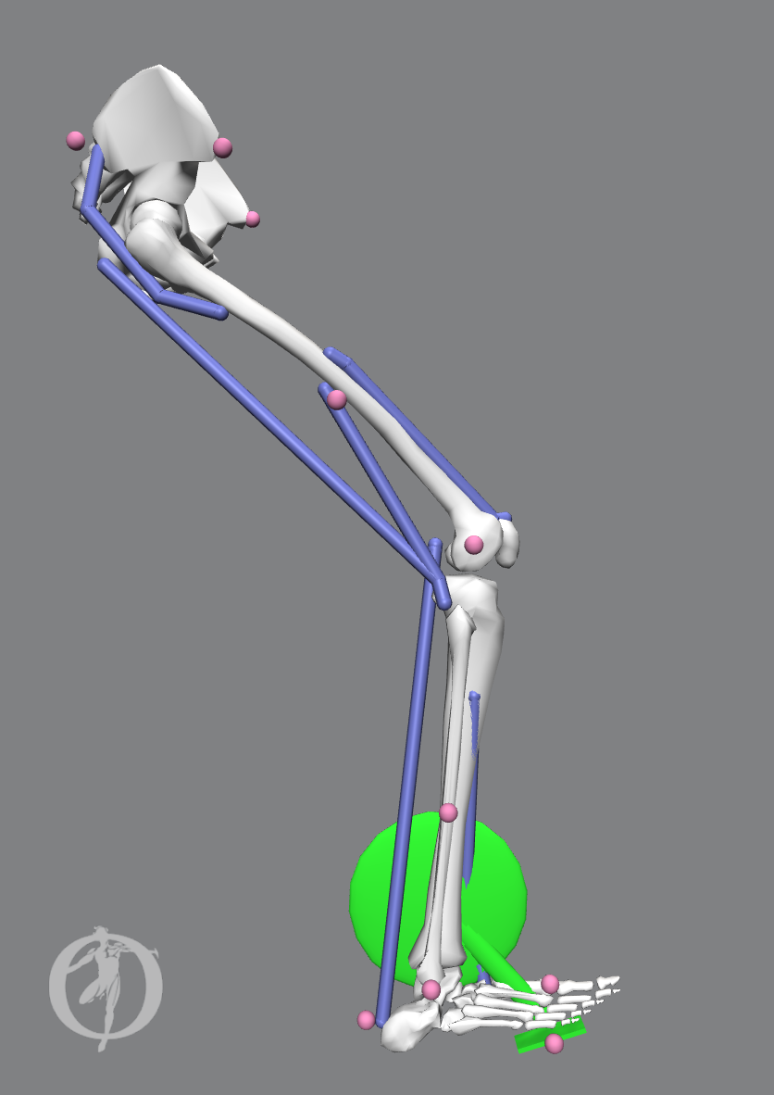
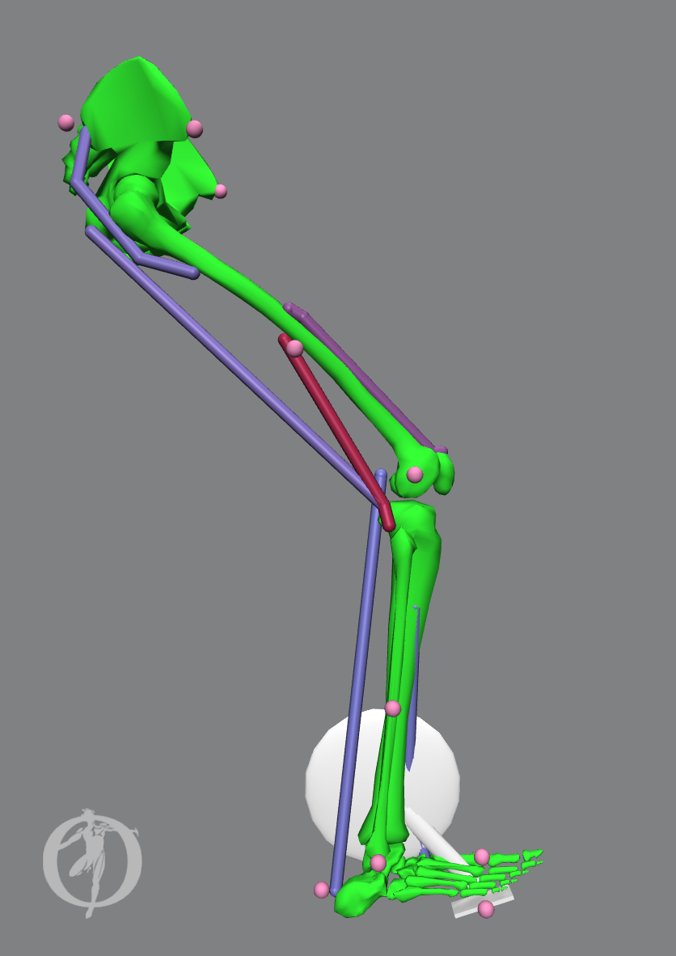
Workflow
(Passive) Simulated Forward Kinematics
(Active) Computed Muscle Control
Parameterized input: Saddle Position
Muscle Activations: [A₁ , A₂ , … A_{n}]
Muscle Forces: [M₁ , M₂ , … M_{n}]
Metabolic Energy Expenditure:
[E₁ , E₂ , … E_{n}]
Trial 1 (x₁ , y₁)
Joint Angles: [Q₁ , Q₂ , … Q_{n}]
Muscle Lengths: [L₁ , L₂ , … L_{n}]
Muscle Velocities: [V₁ , V₂ , … V_{n}]
External forces: [F₁ , F₂ , … F_{n}]
Trial 2 (x₂ , y₂)
...
Trial n (x_{n} , y_{n})
n = trial number
= driving the motion
Notes:
Parameters: GRFs, saddle height/position, kinematics, cadence,
The first step will always be making any necessary adjustments we need to make to the OpenSim model for the next iteration. It’s at this point where we choose a new saddle position for a example.
Then we generate a new set of joint angle trajectories and external force profiles using the adjusted model for our CMC Tool.
We then need to tailor the OpenSim specific files and scripts that the CMC Tool requires. The content of these files are directly influenced by every aspect of the OpenSim model, and so they must be updated for every physical change made to the model.
With all of the files needed for the CMC Tool organized, we can finally simulate a pedaling motion for the model and extract outputs of interest such as muscle excitation profiles and metabolic energy consumption probes.
Lastly, before beginning a new iteration cycle, it is important to compare the simulation outputs to our previous iterations to judge what qualitative improvements are being made.

Slide 16
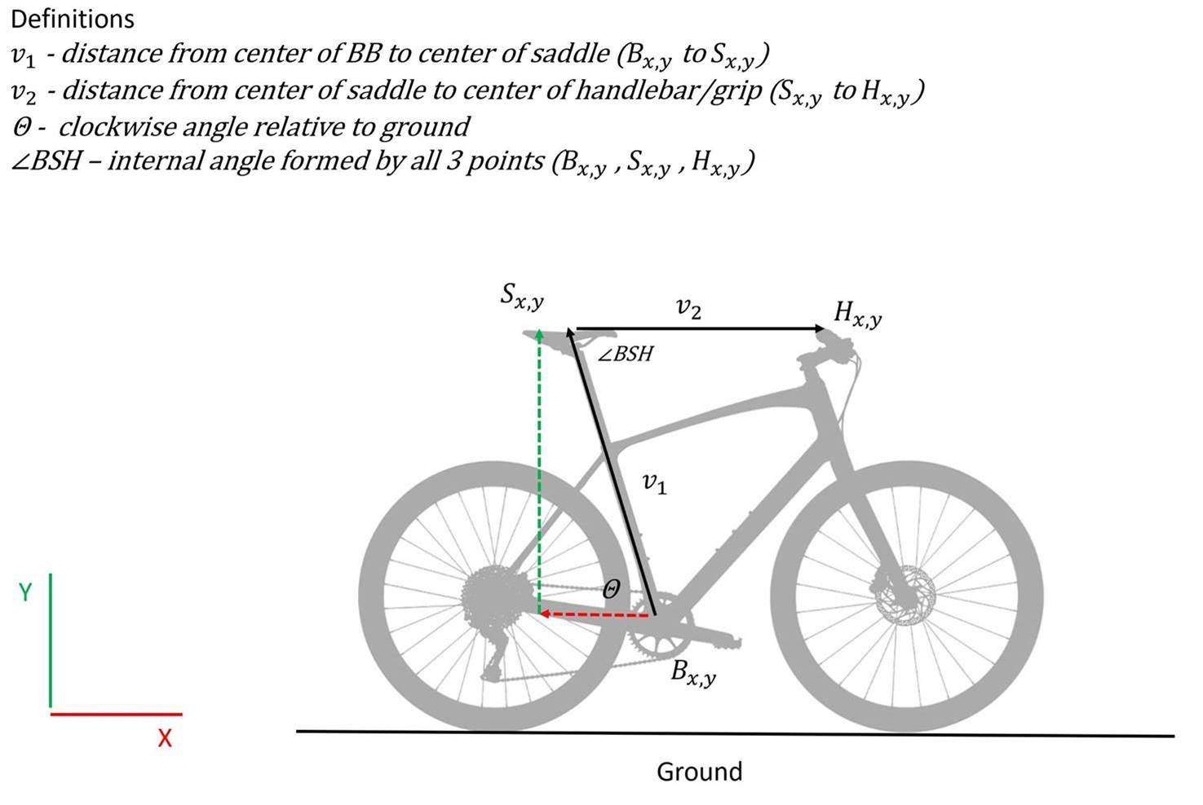
Adjust OpenSim Model Input
Saddle position, S_{x,y}
[18]
dg
Notes:
Constraints
Muscles
Cadence
https://simtk-confluence.stanford.edu/display/OpenSim/OpenSim+Teaching+Materials+--+Educational+Cycling+Model
Included muscles are 1 quadriceps head (vastus intermedius), hamstrings (biceps femoris long and short heads), and gluteus maximus.
Constr
4 upper leg muscles, pelvis constrained to saddle, metatarsal constrained to pedal
1 muscle excitation forward dynamics External forces generated from forward dynamics constraints

Slide 17
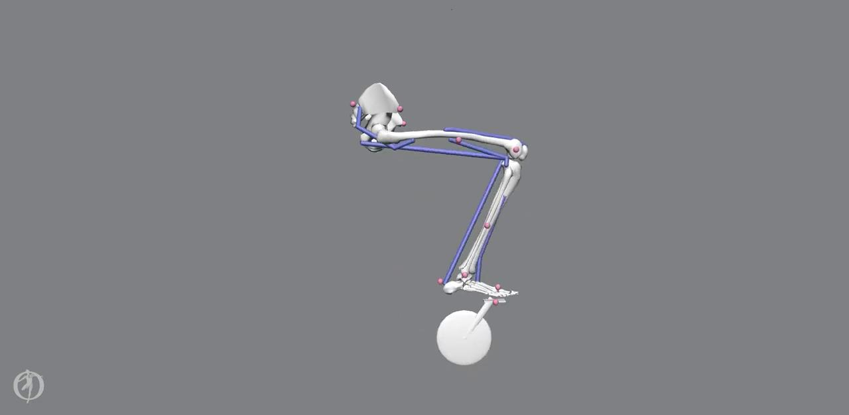
Simulate Passive Model for Kinematics
dg
Notes:
Speed is 0.5x
This is what we will refer to as our “bare bones” cycling model. It is adapted from the original ME 485 model, however we strip off the musculature completely, leaving us with only rigid bodies and free of dissipative forces.
We then allow the pelvis to be locked in space, essentially fixed to the saddle position, and the foot constrained to the pedal. The crank angle is prescribed to a linearly increasing function in time, yielding a constant cadence.
This is the streamlined approach we will use to capture joint angle trajectories as we iterate through a wide range of saddle positions.

Slide 18
Adjust OpenSim CMC Tool Input Files
Setup File
Motion File (Kinematics)
Tracking Tasks File
Actuators & Controls
External Forces (GRFs)
[17]
cec
Notes:
CEC Additional Constraints File (optional)
each of the files is specific and must be tailored to accommodate each model’s kinematics and anthropometric measurements
files must be specific for each model’s kinematics because the human body is highly variable
Muscle (length, velocity, activation)
High flexion/low flexion conditions
Realistic dynamics is optimization problem of different combo of muscles activations and timings
Multi scale model (muscles; bones; over large joint angles)
we have established a set of overall files --> expect and anticipate minor modifications needed in between kinematic sets
TT weights actuation constraints
Confirmed with opensim expert as best version of streamlined process

Slide 19
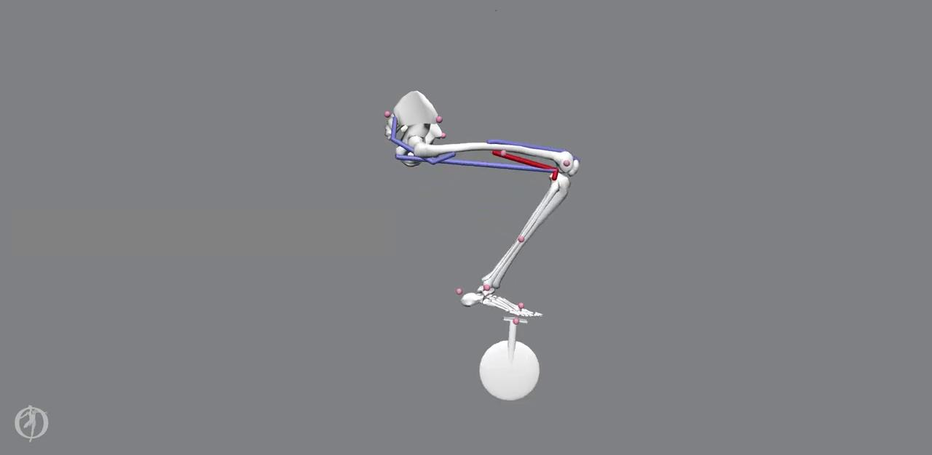
Run CMC Tool with Metabolic Probes
CMC Trial 8e
cec
Notes:
CEC
Step 4: run CMC Tool and extract muscle excitations and metabolic probe data
See in the following slides what constitutes criteria for acceptable results
Next steps for testing:
Change saddle position (X,Y)
Discover how changes affect muscle activations & metabolic cost

Slide 20
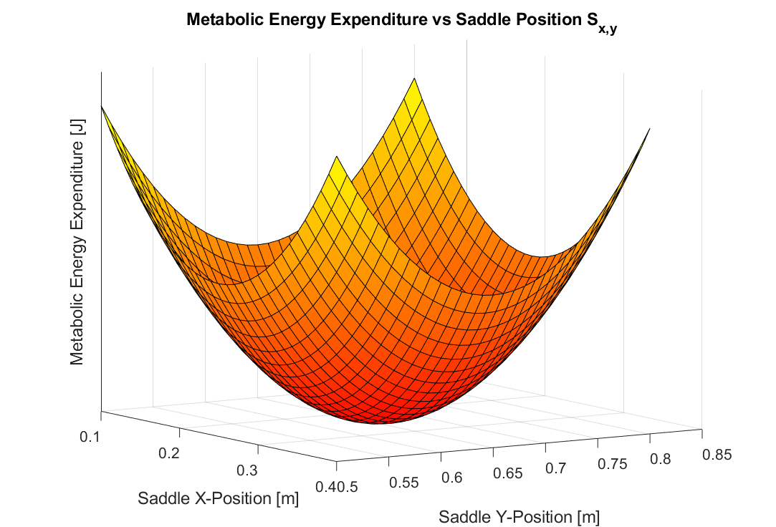
Compile Results
Idealized plot of metabolic energy expenditure vs. saddle position
Muscles Activation: [A₁ … A_{n}]
Muscles Forces: [M₁ … M_{n}]
Metabolic Energy Expenditure:
[E₁ … E_{n}]
cec
Notes:
Each muscle, given it’s force length and force velocity relationship can output a potential maximal force (given fiber length, fiber velocity) over time of a crank rotation
CEC
With our simple model, we were able to complete the final step in our workflow to show a successful CMC run.
All 4 muscles are activated in the pedaling motion.
The overall kinematics of the hip, knee, and ankle joints are acceptable
Achieved constant cadence model
we have since achieved similarly successful results with other models.

Slide 21
Timeline
→ Currently in progress
Week 2 | Week 3 | Week 4 | Week 5 | Week 6 | Week 7 | Week 8 | Week 9 | Week 10
1/22 | 1/29 | 2/5 | 2/12 | 2/19 | 2/26 | 3/5 | 3/12 | 3/19
OpenSim learning |  |  | Define workflow | Parameterize saddle height
Literature research |  |  |  | Develop higher complexity models (2-leg, additional muscles)
Workflow development |  |  | Ensure GRF at pedals is reasonable |  |  | Collect data on parameterizations
Meet with OpenSim experts & document research and process thoroughly
 | Compute muscle forces & metabolic output through CMC
cec
Notes:
[cc] This timeline has a visual representation of our work for the next several weeks. The blocks in green are currently being worked on and we have a couple weeks at the end for buffer and final wrap up activities.

Slide 22


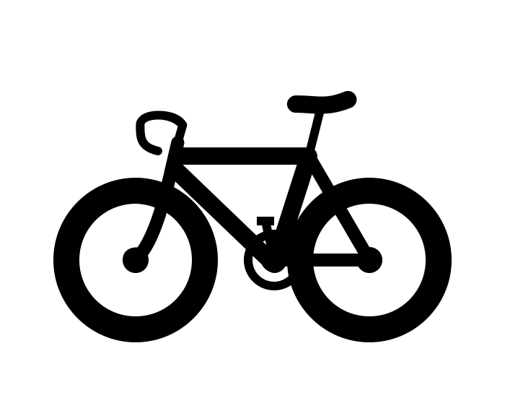

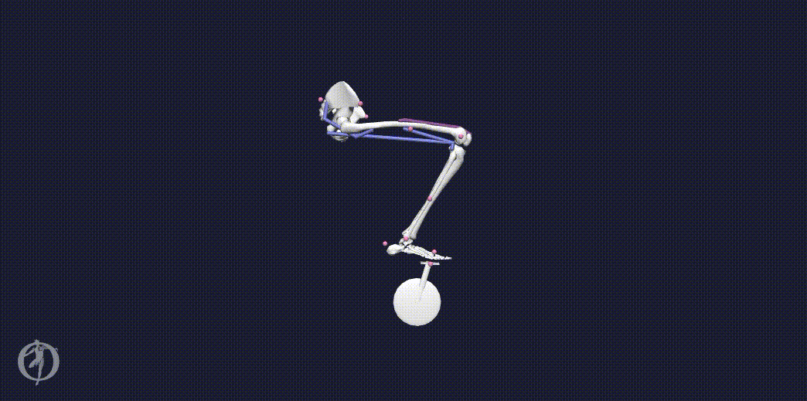
Thank you
INSERT BLOOPER GIFS
Notes:
1’ - all

Slide 23
References
Kipp, Shaylaya, et al. Extrapolating Metabolic Savings in Running: Implications for Performance Predictions. Frontiers in Physiology, (2019).
Faulkner, S. and Jobling, P. The Effect of Upper-Body Positioning on the Aerodynamic-Physiological Economy of Time-Trial Cycling. International Journal of Sports Physiology and Performance, (2020).
Uchida TK, Seth A, Pouya S, Dembia CL, Hicks JL, Delp SL (2016) Simulating Ideal Assistive Devices to Reduce the Metabolic Cost of Running. PLoS ONE 11
Bini RR, Tamborindeguy AC, Mota CB. Effects of saddle height, pedaling cadence, and workload on joint kinetics and kinematics during cycling. J Sport Rehabil. 2010
Henrot, C and Jeffries, L. OpenSim Teaching Materials -- Educational Cycling Model. BIOE-ME 485 Spring 2018
Dodge, David. The Most Efficient Transportation On the Planet. Huffington Post Online (2013).
Koelewign, A. D. et al. Metabolic cost calculations of gait using musculoskeletal energy models, a comparison study. PLOS ONE 14(9): e0222037, (2019).
Dembia CL, Silder A, Uchida TK, Hicks JL, Delp SL Simulating ideal assistive devices to reduce the metabolic cost of walking with heavy loads. PLOS ONE 12(7): e0180320, (2017).
Jackson, R. W. and Collins, S. H. An experimental comparison of the relative benefits of work and torque assistance in ankle exoskeletons. J Appl Physiol 119: 541–557, (2015).
Leib, D. The Effects of Clear Placement on Muscle Mechanics and Metabolic Efficiency in Prolonged Sub-Maximal Cycling. Ball State University Biomechanics Laboratory Thesis, (2008).
Pottinger, M. Inverse Dynamic Analysis of ACL Reconstructed Knee Joint Biomechanics During Gait and Cycling Using OpenSim. California Polytechnic State University, San Luis Obispo Thesis, (2018).
Coleman DA, Wiles JD, Davison RC, Smith MF, Swaine IL. Power output measurement during treadmill cycling. Int J Sports Med. ;28(6):525-30, (2007).
Peveler, W. and Green, J. Effects Of Saddle Height On Economy And Anaerobic Power In Well-trained Cyclists. National Strength and Conditioning Association , Vol 25, 3, (2011).
Hull, M.L. and Jorge, M. A Method For Biomechanical Analysis of Bicycle Pedalling. Journal of Biomechanics Vol 18 No 9. pp 631-644, (1985).
Gonzalez, H. and Hull, M.L. Multivariable Optimization of Cycling Biomechanics. Journal of Biomechanics Vol. 22 No 11/12 pp 1151-1161, (1989).
“hip angle” Ducking Tiger. Web. Accessed 4 February 2021. <https://www.duckingtiger.com/can-we-use-road-bike-instead-of-tri-bike/hip-angle/>
“Getting Started with CMC” OpenSim Documentation. Web. Accessed 24 January 2021. <https://simtk-confluence.stanford.edu/display/OpenSim/Getting+Started+with+CMC>
Tucker, J. Personal E-mail Correspondence. 13 January 2020.

Slide 24
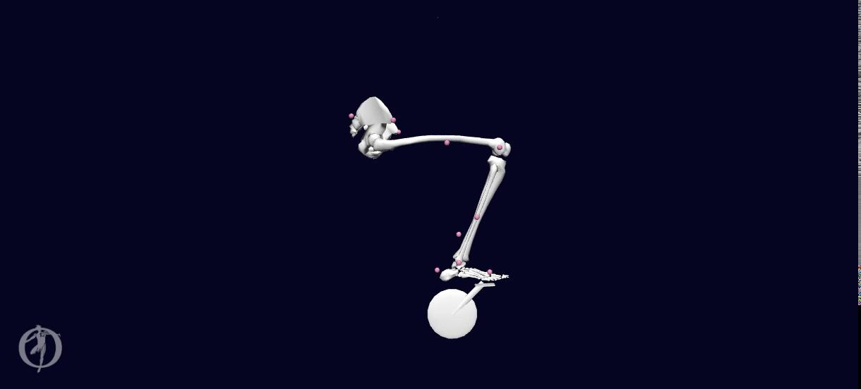
Updates: Constant Cadence
Using bare bones model
Notes:
Carmichael said we should just do with all muscles since we can drive cadence at constant speed

Slide 25

Updates: Muscles Added
Gastrocnemius added
Gastrocnemius & Tibialis Anterior added

